Slide 1


RefinedTech: Secure Multi-User eCommerce Platform for Tech
A Smart Marketplace for Buying & Selling Used Electronics

Slide 2

Project Overview & Team
Salman Faresi, ID : 20220104007
Maisha Momtaz Meem, ID : 20220104049
Jarin Tasnim, ID : 20210204105
Tajuddin Ahmed , ID : 20220104157
Course: CSE 3100 - Software Development-IV
Instructor: Mr. Md. Zahid Hossain & Mr. Parvez Ahammed
Submission Date: September 21, 2025

Slide 3

Table of Contents
01
02
Main Features
Technologies Used
Core functionalities of the platform.
Key components of our tech stack.
03
04
System Architecture
Key Highlights & Challenges
How the different parts connect.
Technical achievements and solutions.
05
06
Demo Flow (User Journey)
Live Demonstration
Step-by-step user experience.
Putting RefinedTech into action.

Slide 4







Core Features & Functionality
Multi-Role Authentication
Advanced Product Management
Smart Shopping Experience
Buyers (instant), Sellers (admin approval), Admins (access code).
40+ attributes, condition verification (Like-new, Excellent, Good, Fair).
Cart, wishlist, AI recommendations, advanced filtering.
Secure Communication
Order Management
Admin Dashboard
Buyer-seller messaging for product inquiries.
Complete order lifecycle with status tracking.
User approval, access code, platform monitoring.
Security Features
Document verification, fraud detection.

Slide 5

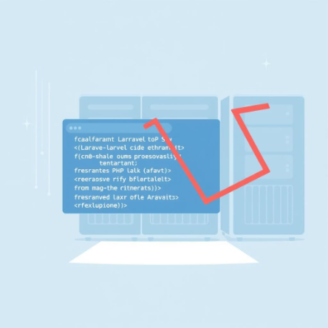
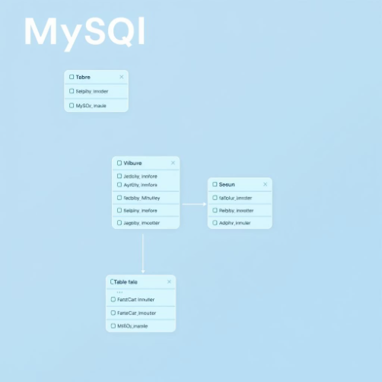

Technology Stack
Frontend
React 18 with JavaScript
Vite for build tooling
Framer Motion & GSAP for animations
Backend
Custom CSS with responsive design
Laravel 12 with PHP 8.2
Laravel Sanctum for authentication
RESTful API
architecture (50+ endpoints)
Multi-guard authentication system
Database
MySQL with optimized schema
Separate tables for user roles
Development Tools
20+ database tables with relationships
Composer & NPM package managers
Git version control
Thunder Client for API testing
WakaTime for productivity tracking

Slide 6





System Architecture Overview
Laravel Backend
API & Auth Layer, Sanctum, CORS, Middleware
React Frontend
MySQL Database
User Interface, Role-based UI, Responsive, State Management
Data Storage: buyers, sellers, admins, products, orders
Key Components
Multi-table authentication system
Role-based access control
RESTful API design
Secure file upload handling

Slide 7


Technical Achievements & Solutions
Challenge 1: Multi-Table Authentication
Challenge 2: Hierarchical Admin Access
Problem: Separate user types (buyers, sellers, admins) needed distinct approval workflows.
Problem: Required super admin and regular admin roles with controlled registration.
Solution: Implemented Laravel Sanctum with custom multi-auth middleware supporting separate database tables.
Solution: Created an access code system for secure admin onboarding.
Achievement: Secure, controlled admin onboarding with proper permission hierarchy.
Achievement: Seamless, permission-isolated authentication for all user roles.
Technical Pride Points
From Scratch Development
120+ Hours Invested
No pre-made templates used; pure custom build.
Dedicated development time tracked for efficiency.
Comprehensive API Testing
Modern UI/UX
Detailed documentation ensures reliability.
Responsive design with smooth, engaging animations.

Slide 8

User Journey Overview
Buyer Journey
Seller Journey
Admin Journey
Register → Instant approval
Register with Documents
Register with Access Code
Browse Products
Admin Approval
Add to Cart/Wishlist
List Products
Dashboard Access
Manage Inventory
Secure Checkout
Approve/Reject Users
Track Orders
Process Orders
Communicate with Buyers
Monitor Platform
Generate Access Codes
These pathways highlight the distinct yet interconnected experiences within RefinedTech, demonstrating our multi-user design.

Slide 9

THANK YOU

